Slide 1
Entity Framework - Code First

Slide 2
What is Code First
Code First means you can start storing and retrieving information from a database without creating a database schema
Other options with Entity Framework
Database First
Model First
Database interaction is performed via the simple model classes aka Plain Old CLR Objects, or POCOs
you write plain C# classes and EF figures out how, and where, to store instances of those classes.
EF follows a number of conventions to make your life easier. For example, if you want to store an object of type Album in the database, EF assumes you want to store the data in a table named Albums
The table and column names are derived automatically from your model class and properties
Keys are derived from column names finishing with “ID”

Slide 3
Code First Features
Define objects in POCO (Plain Old CRL Objects)
No special base class required
Database persistence without configuration files
Can use Data Annotations for finer control (or the Fluent API) to overcome conventions e.g.
[Key] – specify a column as a key
[Required] - not null
[Table] - specify table name
DbContext derived class
Primary object to interact with a database
DbSet<TEntity> properties in context class
Used to perform CRUD against a specific type from the model

Slide 4


DBContext
DBContext class acts as your gateway to the database, providing all of the data-related actions you might need.
You derive a class form DbContext and add properties of type DbSet<T> where T is the objects you want to persist
For example the following example allows to store and retrieve author and publisher details
Using the Pubs2013Entites Db context you can retrieve all male authors in alphabetical order using the LINQ query in the following code:

Slide 5

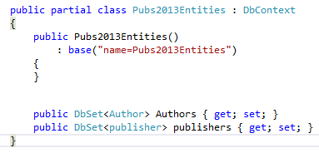
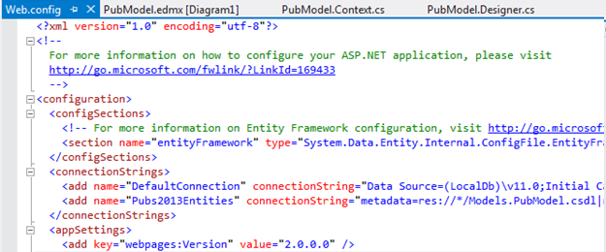
DBContext & DBSet Classes
System.Data.Entity.DbContext
DBContext class acts as your gateway to the database, providing all of the data-related actions you might need.
You derive a class form DbContext and add properties of type DbSet<T> where T is the objects you want to persist.
By default , the database connection string to database will be same name as your DbContext class
You can change this name by including it as a parameter to the DbContext constructor

Slide 6
DbContext : Examples
Get all authors
Pubs2013Entities context = new Pubs2013Entities ();
var allAuthors = from authors in context.Authors
where authors.Gender == “Male”
orderby authors.LastName ascending
select authors
Add Object
Pubs2013Entities context = new Pubs2013Entities ();
Author a = new Author { FirstName = "Testy", LastName = "User" };
context.Authors.Add(a);
context.SaveChanges();
Delete Object
Pubs2013Entities context = new Pubs2013Entities ();
Author a = context.Author.Find(1);
context.Authors.Remove(p);
context.SaveChanges();

Slide 7
Code First Conventions
Convention over configuration
Database naming (connection string name = DbContext derived class name)
Table name (pluralisation of model class, entity property names used as column names)
Primary Key (table primary key = property named ID or classameID)
Foreign Key
SQL Server Express – default database

Slide 8
Data Annotations
It’s not enough always to use the conventions
Data Annotations tells EF more explicitly how to map the object model to the database model
Place annotations directly against the property in your class.
System.ComponentModel.DataAnnotations

Slide 9
Common Data Annotations
[Key] – Defines a Primary Key
[Column] – Defines column name in a table
[Table] – Defines table name for a class
[Required] – Defines a Required table field
[MinLength()] – Min length for a property
[MaximumLength()] – Max length for property
[Range()] – Defines a valid value range

Slide 10
Data Annotation - Example
[Table(“Product_Order")]
public class Order
{
[Key]
[Column("Order_ID")]
public int OrderId { get; set; }
public DateTime Date { get; set; }
public OrderState State { get; set; }
public string Item { get; set; }
[Range(1, 25)]
public int Quantity { get; set; }
[MinLength(3, ErrorMessage="What are you thinking?")]
[MaxLength(50, ErrorMessage="ERROR!!")]
public string Name { get; set; }
public string Note { get; set; }
}

Slide 11
Migrations
Migrations is a new way to generate database changes automatically
It’s controlled through PowerShell commands
Can migrate forward or rollback DB changes.
Migrations can be handled automatically. EF will automatically apply change scripts

Slide 12
Enable Migrations
To turn Migrations on
This creates a Migration folder in project
Creates Configuration.cs file
Creates __MigrationHistory system table in DB
PM> Enable-Migrations

Slide 13
Add Migration
PM> Add-Migration "Inital" -IgnoreChanges
“Initial” is the name of the migration
The –IgnoreChanges switch tells EF to create an empty migration. Use this if this is the first migration and EF did not create the DB.
Creates a cs file with the changes since the last migration.
Does not apply changes to DB.

Slide 14
Update Database
PM> Update-Database
Pushes the migration changes to the DB
Use the –script switch to have EF create a SQL script of the changes.
Use –TargetMigration to determine end point for DB. (Rollback/Forward)

